Slide 1
Project 1: Speed Dating
Jonathan Bae, Haotian Li

Slide 2
Quick Glance
47% of American adult males over age 18 are single
Compared to men that speed date, women select half as many partners
Overall Goal: The objective of this study was to find what makes females decide yes to a male
Our findings show:
As a male, if you are attractive and funny, you will get the most yes
Notes:
http://www.census.gov/newsroom/facts-for-features/2015/cb15-ff19.html
http://www.nyeasydates.com/speed_dating_articles/want_to_try_speed_dating_consider_these_statistics.html

Slide 3
Data Cleaning
Predictors: Used men’s characteristics, events characteristics, and ratings for men
Classifier: Whether women partners said yes or no (dec_o)
Imputation:
If N/A rating for attributes attr_o, sinc_o, intel_o, fun_o, amb_o use mean score of the iid
If N/A coding for field_cd or career_c use code value similar corresponding careers and fields
Remove rows where no age or date preference values per iid
Change met values to either 1 (met previously) or 2 (have not previously)

Slide 4
Tree Model
Feature Selection:
Select following variables:
Men’s characteristics:
field_cd, career_c, age, race, met, date, exphappy, sports, tvsports, exercise, dining, museums, art, hiking, gaming, clubbing, reading, tv, theater, movies, concerts, music, shopping, yoga, goal, go_out,
Event’s characteristics:
round, magazine
Ratings to men:
attr_o, sinc_o, intel_o, fun_o,amb_o
Used C5.0 tree and CTree

Slide 5
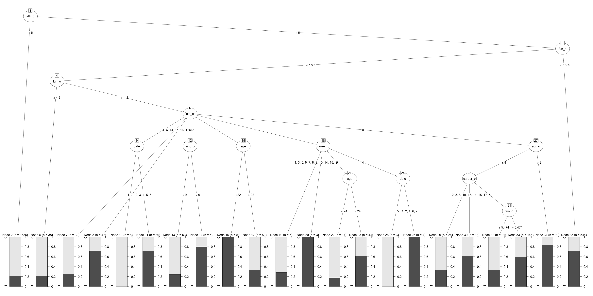
Classification (C5.0 Tree)
When you not attractive or funny enough
When you are very attractive and funny
Notes:
Higher accuracy: 73% accuracy
Hard to interpret, seems like overfitting
Field_cd n career_cd have a lot potetial outcomes

Slide 6
Classification (CTree)
Attractiveness and funniness always matter
Field and sincerity matter when you are attractive
Notes:
Lower accuracy: 70%
Less attributrs used, No overfitting because of the signficance test

Slide 7
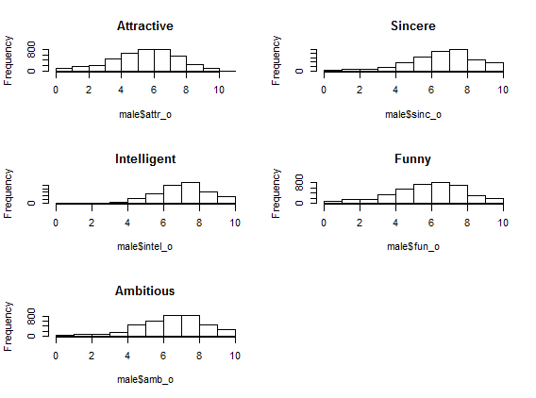
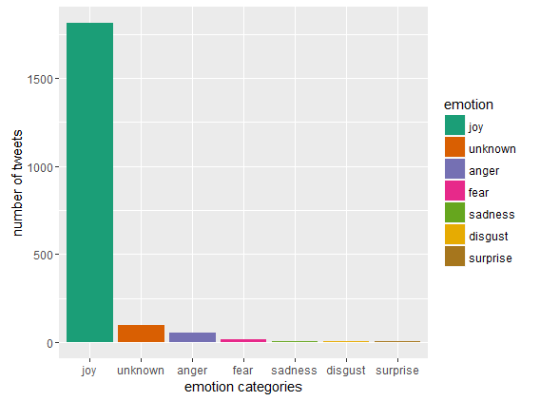
Ratings may be biased
Attractive has more normal distribution
Sentiment analysis for a related word “LOVE”:
People generally tweet the word “LOVE” with emotion joy

Slide 8
Conclusion
Final recommendation:
Be good looking
Be funny
Be more sincere if you are both
Further Research:
Ratings to men might not be unbiased estimate of men’s characteristics
Include education and income measurement

